Slide 1
Task ID# GRC-3124.001 - An Evolutionary AI-based Fuzz Testing for Extensive SoC Security Verification Mark Tehranipoor (PI) & Farimah Farahmandi (Co-PI) Date: July 25, 2024 ECE Department, University of Florida

Slide 2










Introduction
Task Leader (PI)
Co-PI
Mark Tehranipoor, Chair at ECE Dept.
Farimah Farahmandi
Assistant Professor
ECE Dept., University of Florida
Student
Muhammad Monir Hossain
Expected Grad. (Ph.D.): Aug 2024
ECE, University of Florida
Industrial Liaisons
Ariton Xhafa
Doug Gardner
Hungwen Li
Sohrab Aftabjahani
Sandhya Koteshwara
Sudhir Mathane

Slide 3
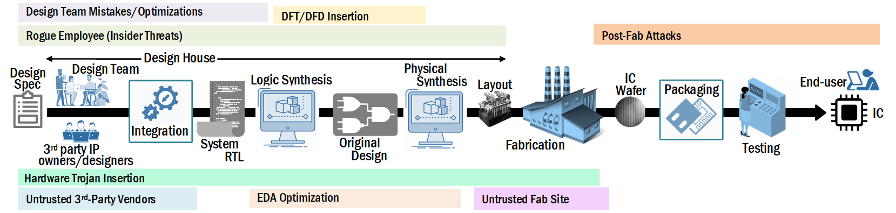
Background
Technical Thrust
Diverse sources of security vulnerabilities in SoC design life-cycle → compromise security
Existing vuln. detection techniques suffer from scalability, manual process, low coverage/detection, and only target known attacks
Objective: Development of robust SoC security verification framework--
to detect diverse set of vulnerabilities
to resolve challenges in current practices, and possibly detect unknowns

Slide 4
Project Goals – Anticipated Results (3-years)
Building a fuzzing-based SoC security verification framework
Automation, highly scalable, compatibility w/ real-world designs
w/ lightweight instrumentation and effective mutation
Capability of updating/training over time
Effective against newer vulnerabilities

Slide 5
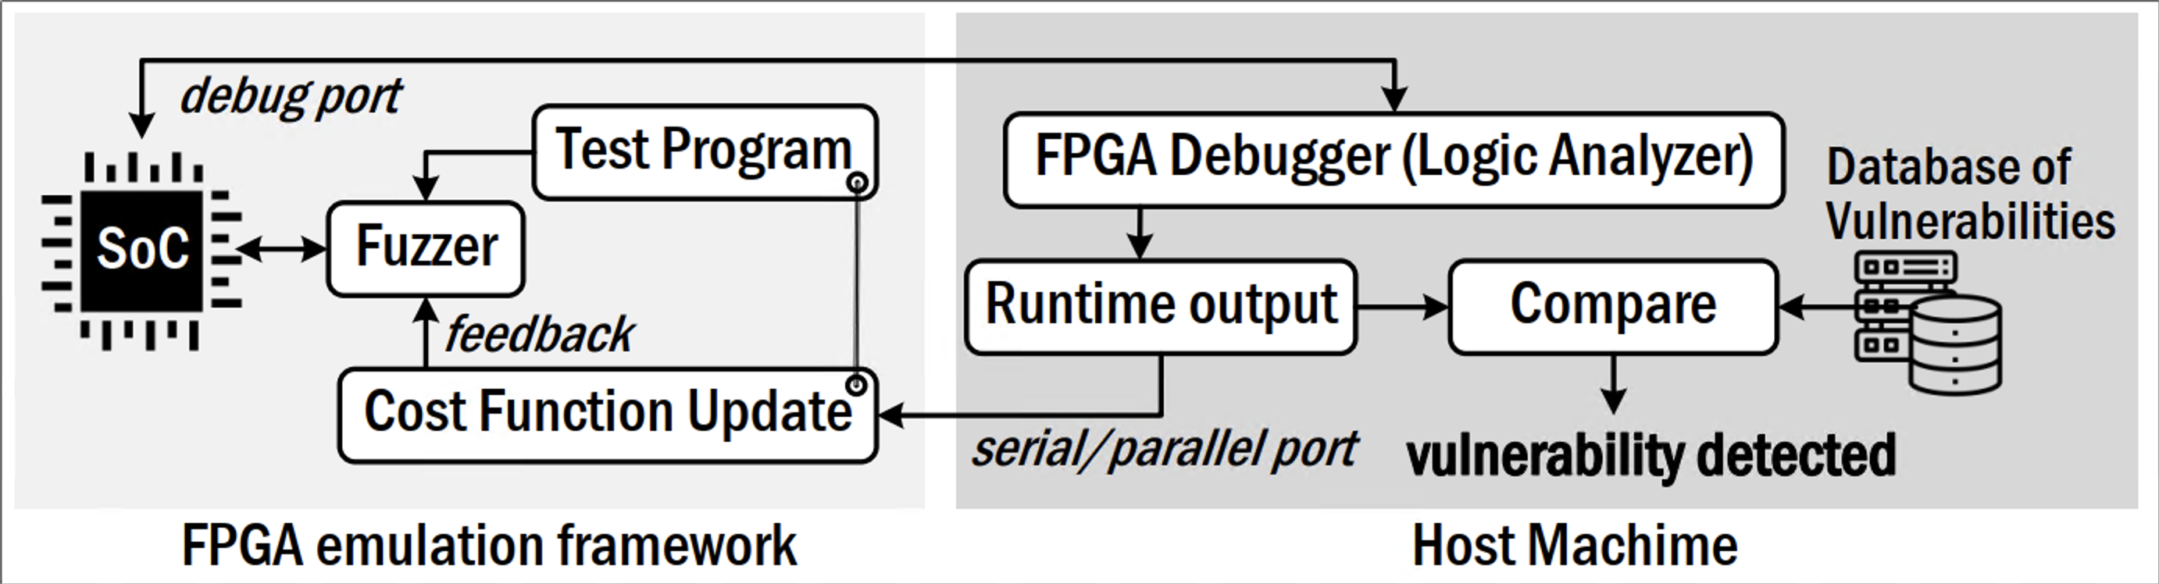
Task Details: Task 1
Task Description
Task 1: Building Fuzz Testing for Automated Cost-function-based Security Verification
Risk assessment → detection of security assets (primary and secondary)
Definition of Adversarial Entry Region → determine adversarial actions for each security asset
Definition of Security Policies/Properties → Constraints for DUT (SoC)
Leveraging cost function to detect known/unknown vulnerabilities
Implementation of Security Verification Model → Convert properties to HW implementation
Proposed Fuzz testing framework (for emulation)

Slide 6
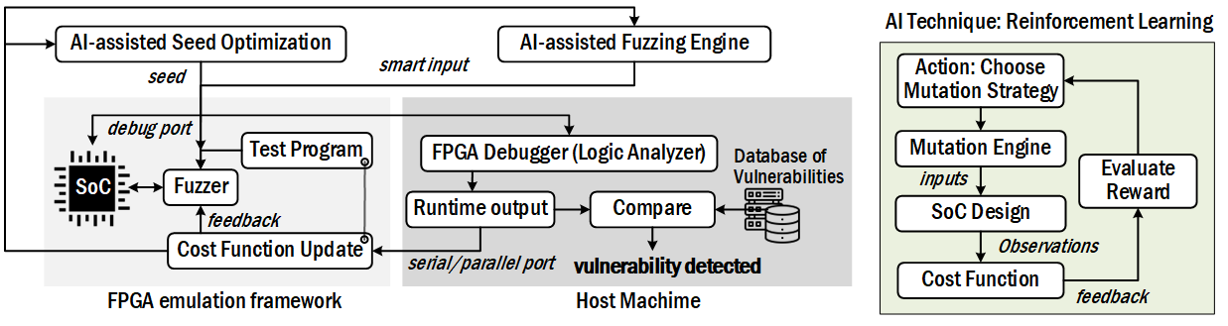
Task Details: Task 2
Task Description
Task 2: Utilization of AI Model for Stimuli Generation for Fuzz Testing
Seed test scheduling → efficient ordering of seeds for faster comprehensive coverage
Mutation steps → interesting inputs (corner cases) and seeds generation for faster vul. trigger
Optimized/useful seed selection → higher coverage and faster vul. Trigger
AI technique: Reinforcement Learning (efficient even with small dataset and learn from actions w/ reward/penalty)
Trained w/ known vulnerabilities → efficient mutations → learn via rewards/penalties for detecting unknown vul.
AI
Integration
Framework from Task 1
Proposed AI-integrated Fuzz testing framework (for emulation)

Slide 7
Task Details: Task 3
Task Description
Task 3: Simulation- and Emulation-based Verification of AI-based Fuzz Testing
Comprehensive testing of AI-based fuzz testing framework (Outcome of Task1+Task2)
Experiments on Ariane RISC-V
Run testing on both simulation (using HW translator to SW by Verilator) and emulation platform (Synopsis Zebu/Genesis-2 FPGA Development Board) and compare with formal approaches
Objective: cover verification of vulnerabilities for all abstraction layers SW/HW/FW
Comprehensive analysis of results
Record verification time, vulnerability types, vulnerability detection coverage
Identify limitations (if any) and potential improvement metrics/factors/scopes

Slide 8
Deliverables and Timelines
10/01/2022 – 09/30/2023
Task Deliverables (Y1 → Y3)
Q1: Analyzing automated security assets identification mechanisms applicable to the SoC architecture (in HW, FW, and SW levels)
Q2: Analyzing the adversarial entry regions (propagation tracking) per each security asset
Q3-Q4: Automation of building the unified language on security properties and building the connection between the language and hardware implementation
Y1
10/01/2023 – 09/30/2024
Q1: Building the security framework with basic fuzz testing (both software-level and hardware-level) and testing the framework
Q2-Q4: Investigating on AI model for mutation/selection, and building/testing the AI model
Y2
10/01/2024 – 09/30/2025
Q1-Q4: The implementation results on a set of RISCV-based SoCs, testing of both simulation- and emulation-based frameworks, analyzing the data, and improvement of the AI model ad fuzz test
Y3

Slide 9
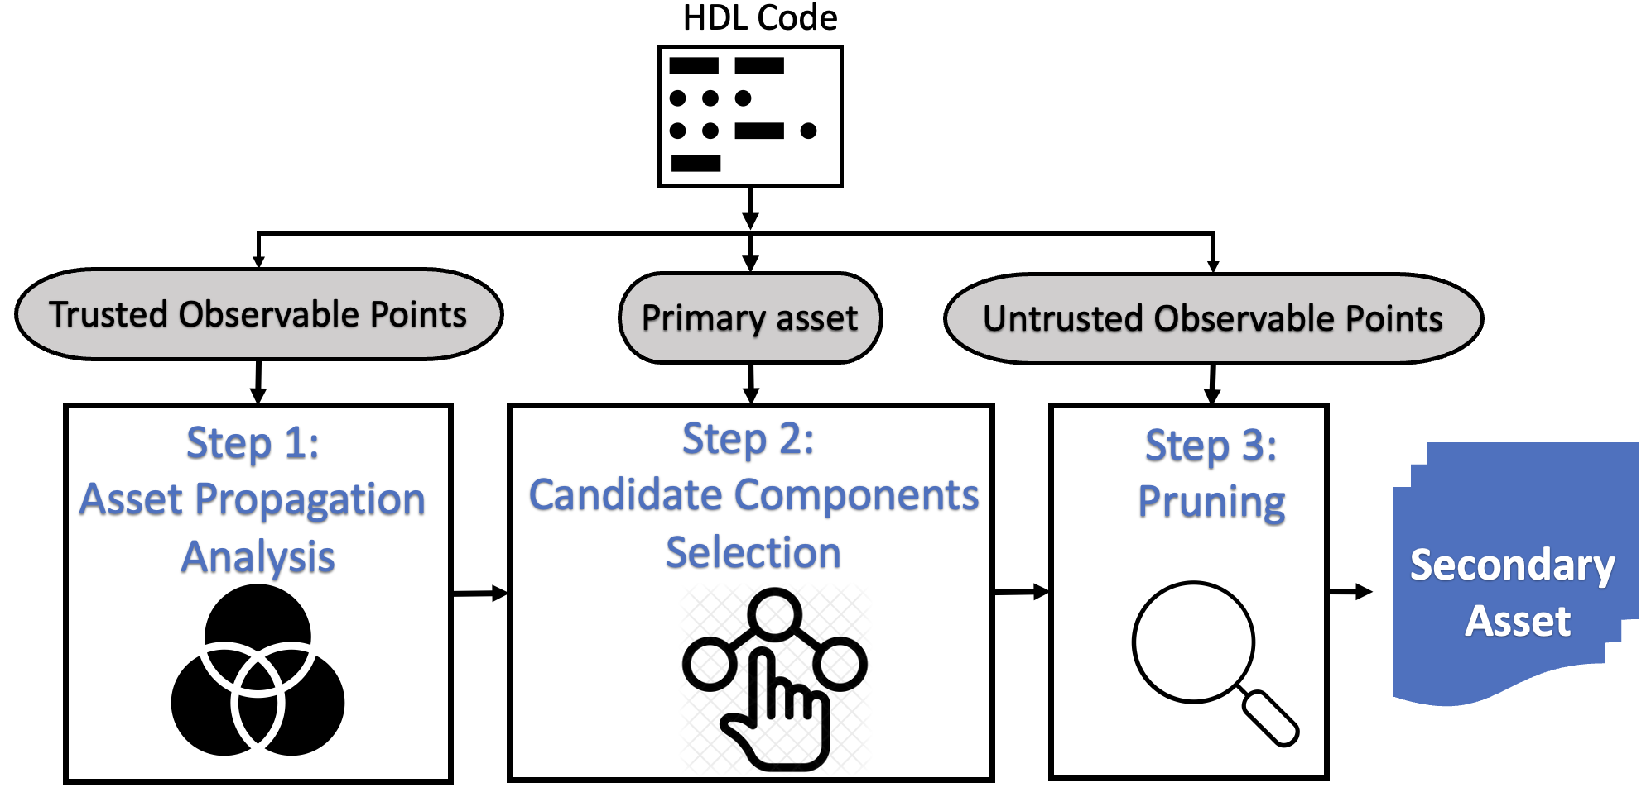
Accomplished Tasks
Completed Task- Q1: Analyzing automated security assets identification mechanisms applicable to the SoC architecture (in HW, FW, and SW levels)
Asset Types
Primary: Known assets defined by SoC design and specification
E.g., cryptographic keys
Secondary: infrastructures interacting w/ primary assets
Proposed Framework
Proposed framework for secondary asset identification (Inspired by SAIF[1]): Three major steps
Step 1: Primary asset propagation analysis; Step 2: Candidate components selection; Step 3: Pruning
Secondary assets detection
[1] Farzana, Nusrat, Fahim Rahman, Mark Tehranipoor, and Farimah Farahmandi. "Soc security verification using property checking." In 2019 IEEE International Test Conference (ITC), pp. 1-10. IEEE, 2019.

Slide 10







Task 1: Building Fuzz Testing for Automated Cost-function-based Security Verification (Completed)
Background - Fuzzing
Motivation
Scalability
Gray/Black
box Model
Automation
No State space Explosion
Max
Coverage
Time
Saver
No False
Alarms
HW Fuzzing
Fuzzing HW as SW
Direct Fuzzing on HW
Current Practices
Pros: Less time required for initial preparation, have low-level permission
Cons: new SW vulnerabilities, very slow
Pros: Faster (emulation) and scalable, Effective for HW/SW co-layer verification
Cons: Limited permissions in low-level

Slide 11

Task 1: Building Fuzz Testing for Automated Cost-function-based Security Verification (Completed)
Challenges in Current Fuzzing Techniques
Inadequate consideration of accurate HW-oriented input mutation
Limited security-driven mutation and feedback
Reliance on traditional SW-based code coverage (lacking mapping to HW design)
Mostly applicable to white-box (full access to the design) model
Limited support of dynamic feedback generation/evaluation for run-time improvement
Proposed Framework to mitigate existing challenges in SoC Verification!

Slide 12
Task 1: Building Fuzz Testing for Automated Cost-function-based Security Verification (Completed)
Proposed Fuzzing Framework: SoCFuzzer
Scalable and automated framework powered by emulation for SoC security verification
Develop evaluation metrics, cost function, and feedback for runtime update of mutation strategies
Global minima of cost function → Vulnerability detection
Implementation →Emulation board: Genesys 2 Kintex-7 FPGA Development Board, SoC: 64-bit RISC-V Ariane
HW debugging: Xilinx Integrated Logic Analyzer (ILA), Monitoring: JTAG, OS: Linux, Mutation Engine: AFL Fuzzer

Slide 13
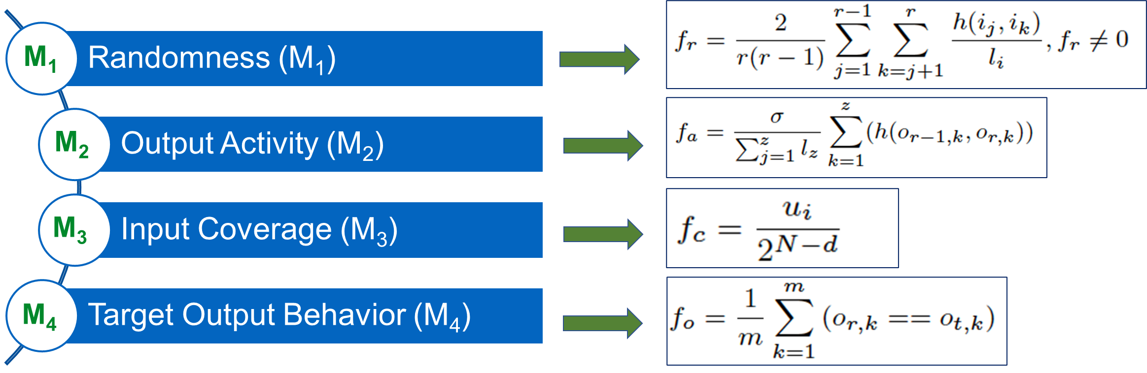
Task 1: Building Fuzz Testing for Automated Cost-function-based Security Verification (Completed)
Fuzzing Evaluation Metrics
Objective: guides fuzzing to generate smarter-than-random test inputs based on metrics
Few metrics based on security properties
Evaluate the quality of mutated inputs
Estimate the chances of hitting a potential malicious behavior
Faster convergence by a feedback utilizing metrics → faster triggering the vulnerability

Slide 14
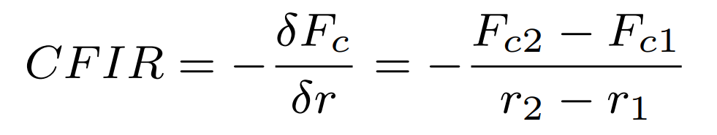
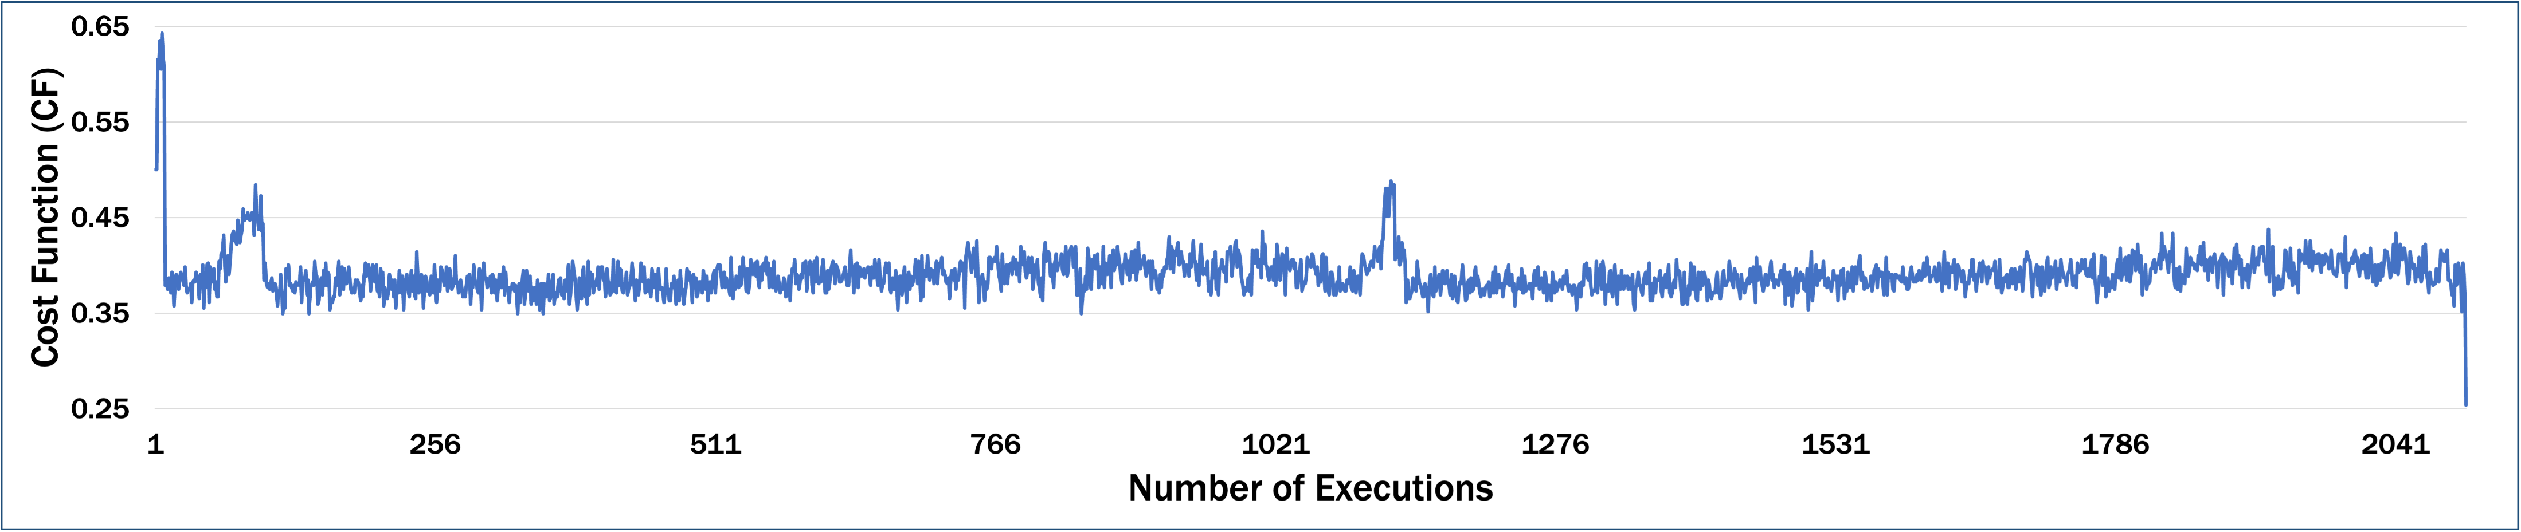
Task 1: Building Fuzz Testing for Automated Cost-function-based Security Verification (Completed)
Cost Function
Developed based on proposed fuzzing evaluation metrics, M1, M2, M3, and M4
Fuzzing objective: minimizing cost function (global minima → vulnerability triggered)
↑ Metrics → better fuzzing → faster vulnerability trigger (global minima)
Feedback
Positive CFIR → better fuzzing → Continue mutation w/ the same mutation strategy
Negative CFIR → Mutation against objective → Change the mutation strategy
Cost Function & Feedback
Realization
Distracted
Target
Global Minima
(Vulnerability Triggered)
Mutation strategy changed

Slide 15
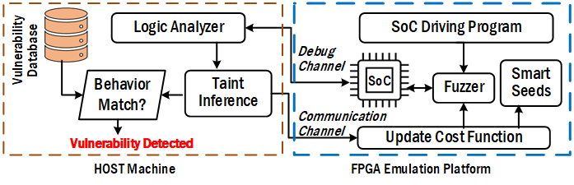


Task 1: Building Fuzz Testing for Automated Cost-function-based Security Verification (Completed)
Proposed Fuzzing Framework: TaintFuzzer
Scalable and automated framework for SoC security verification
Leverage taint propagation for more HW-oriented fuzzing (mutation)
Leverage taint inference for generating smart seeds from initials
Utilize taint inference in cost function and feedback development for efficiency in HW fuzzing
Proposed cost function and feedback for runtime update of mutation strategies
Extensive HW-centric Mutation
Gray-box Model
Verification
Taint Inference

Slide 16

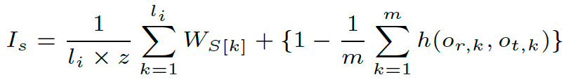
Task 1: Building Fuzz Testing for Automated Cost-function-based Security Verification (Completed)
Internal HW
Design
Taint Inference Rule in TaintFuzzer
Input 1
Output 1
Map output changes to mutated input port
Explicit/implicit dependency
An input port may have multiple tainted output ports
Defined as tainting weight for corresponding input port
Mutation priority on tainting weight and mapping
Gray-box Model
Internal HW
Design
Input 2
Output 2
Gray-box Model
Smart Seeds Evolution
Smart seeds derived based on proposed metric HW Seed Impact Factor (I_{s})
Randomly mutated inputs from initial with seed w/ higher Is → smart seeds
Is considers impact on HW behavior and proximity of malicious behavior
Smart seeds used for longer deterministic mutation (efficient)
HW Seed Impact Factor

Slide 17
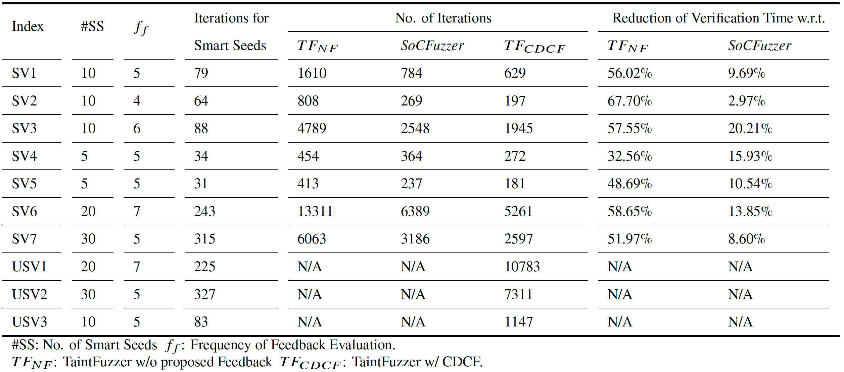
Task 1: Building Fuzz Testing for Automated Cost-function-based Security Verification (Completed)
Summary Results: Vulnerability Detection
Only few iterations required to mutate smart seeds (~6x to ~12x)
Saved at least 32% of verification time w.r.t. fuzzing w/o proposed feedback & 11.68% compared to SoCFuzzer

Slide 18
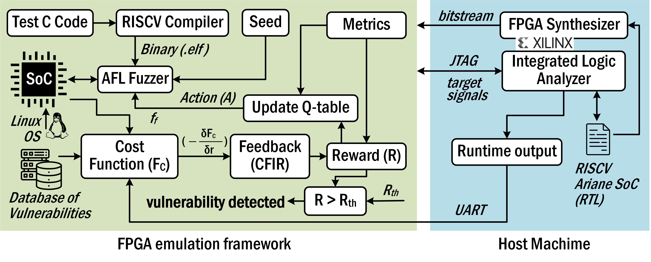
Task 2: Utilization of AI Model for Stimuli Generation for Fuzz Testing ( New Task: In Progress)
Proposed Fuzzing Framework: SoCFuzzer+
Reinforcement learning guided emulation based framework developed based on SoCFuzzer
RL agent utilizes cost function-based feedback to tune the mutation strategies
Increasing cost function → RL penalty, decreasing cost function → RL reward
Vulnerability trigger: Global minima (based on properties) or local minima of cost function
Emulation board: Genesys 2 Kintex-7 FPGA Development Board

Slide 19
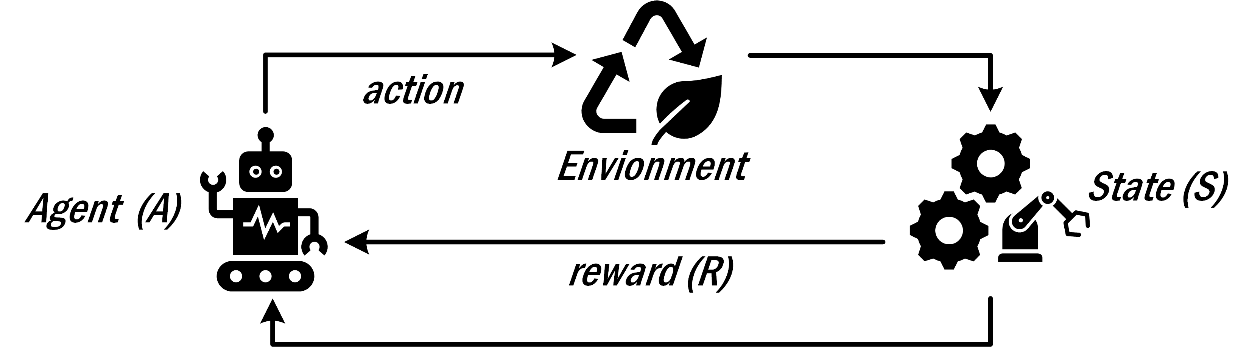
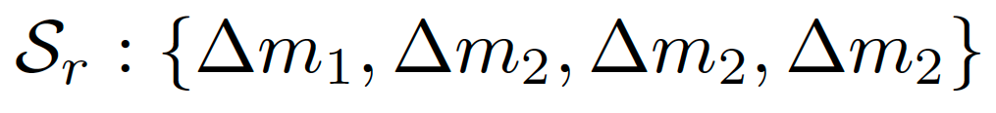
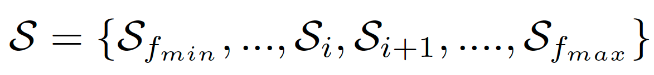
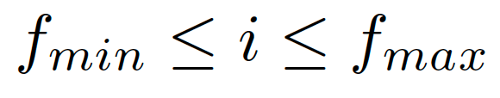
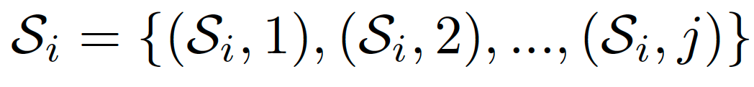
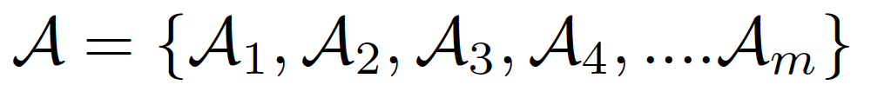
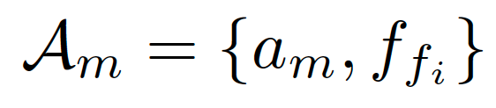
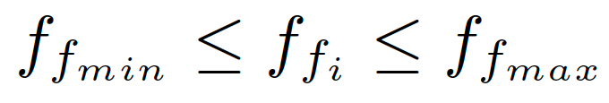
Task 2: Utilization of AI Model for Stimuli Generation for Fuzz Testing
RL Learning
An agent learns to interact w/ environment to maximize cumulative reward
Training agent to make action towards a goal
Action results in feedback as reward or penalty
State Set
Change in metric values define the state
A state: a frequency of feedback evaluation and a mutation strategy
Action Set
An action set is chosen from a particular state for a particular number of iterations in fuzzing
Action set consists of a particular mutation strategy and frequency of feedback evaluation

Slide 20
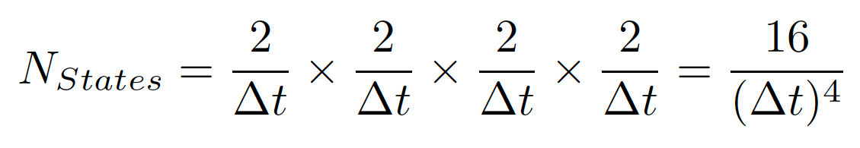
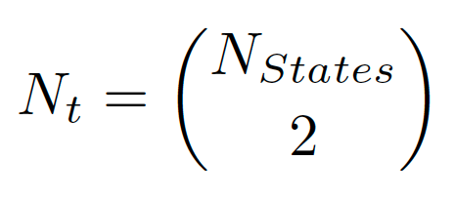
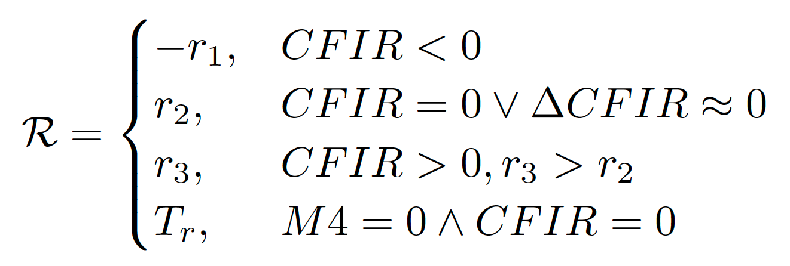
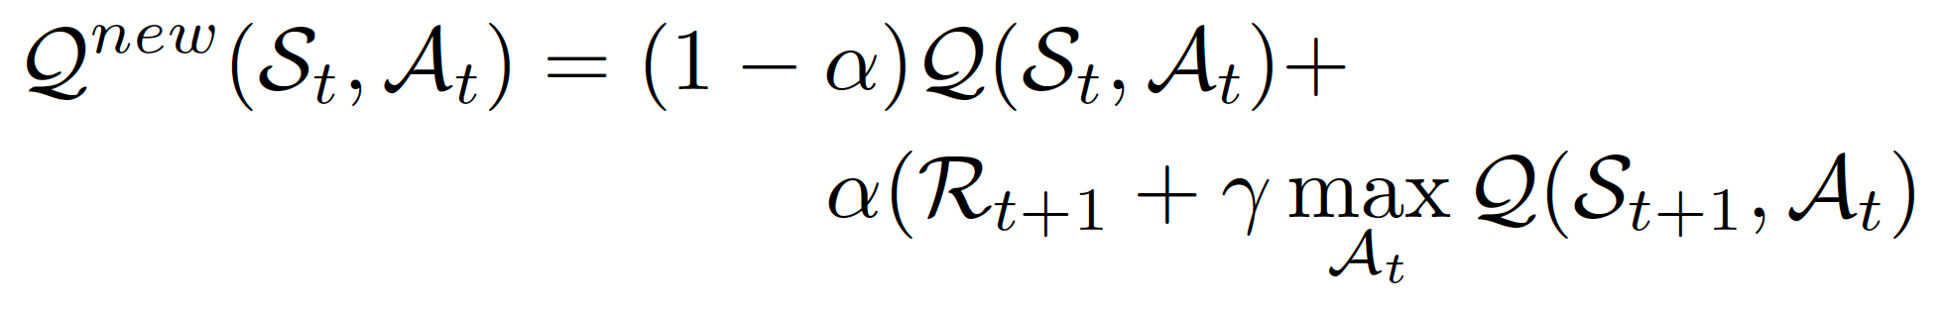
Task 2: Utilization of AI Model for Stimuli Generation for Fuzz Testing
State Transition Function
Determines how likely an against move from one to another state
Implement stochastic state transition for a new module, i.e., initially randomized Q-table
Utilize mature Q-table over time for more deterministic state transition
Action chosen best on the highest reward in Q-table for the current state
Agent Rewards
Provided based on cost function improvement rate (CFIR)
+ve CFIR → Reward, Max reward → CF minima
Negative CFIR → Penalty (negative reward)
Q-Table
Q-table updated after certain iterations
𝛼 → Learning rate, 𝛾 → discount factor

Slide 21
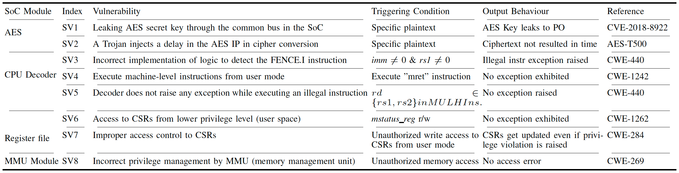
Task 2: Utilization of AI Model for Stimuli Generation for Fuzz Testing
Vulnerabilities in Ariane SoCs

Slide 22
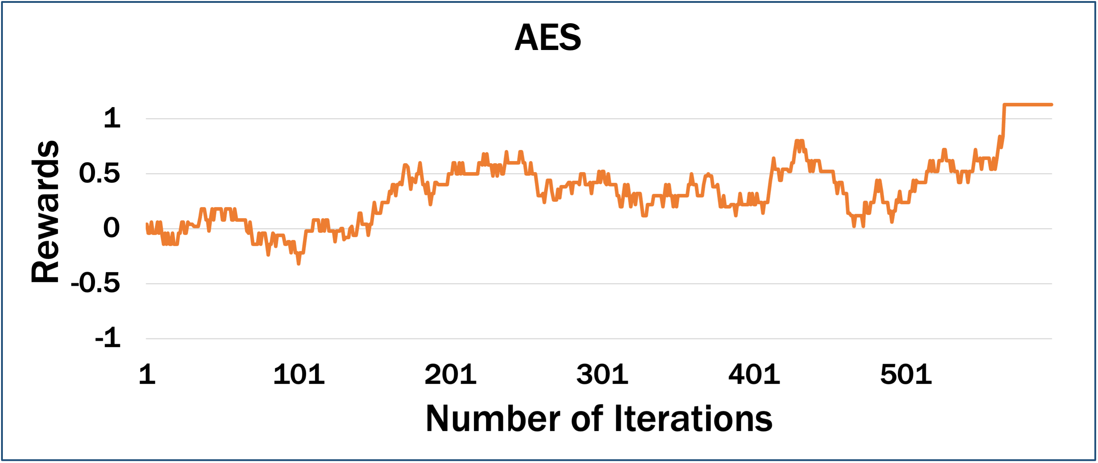
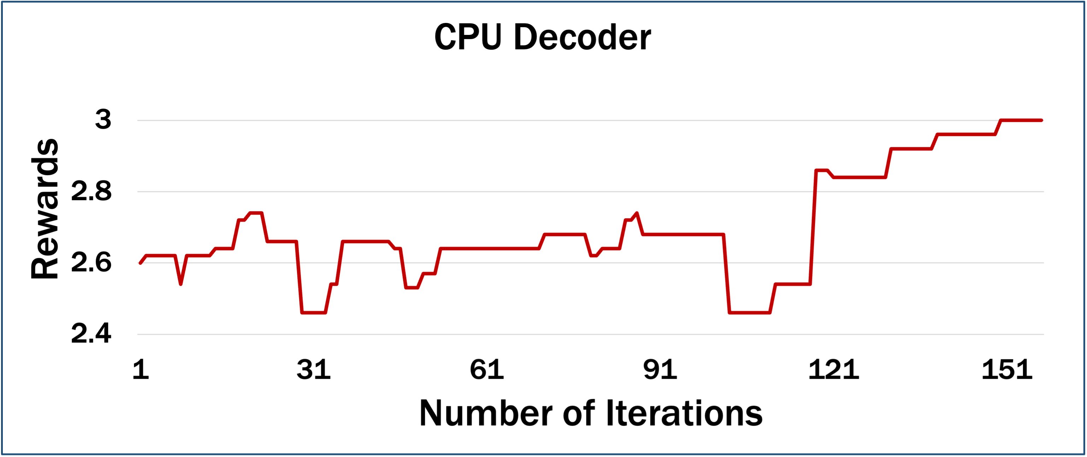
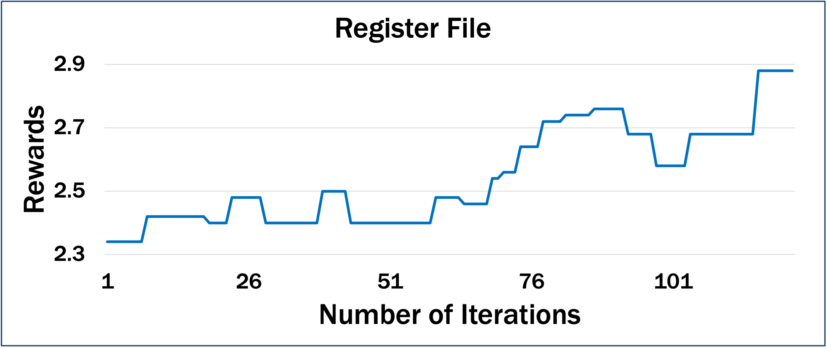
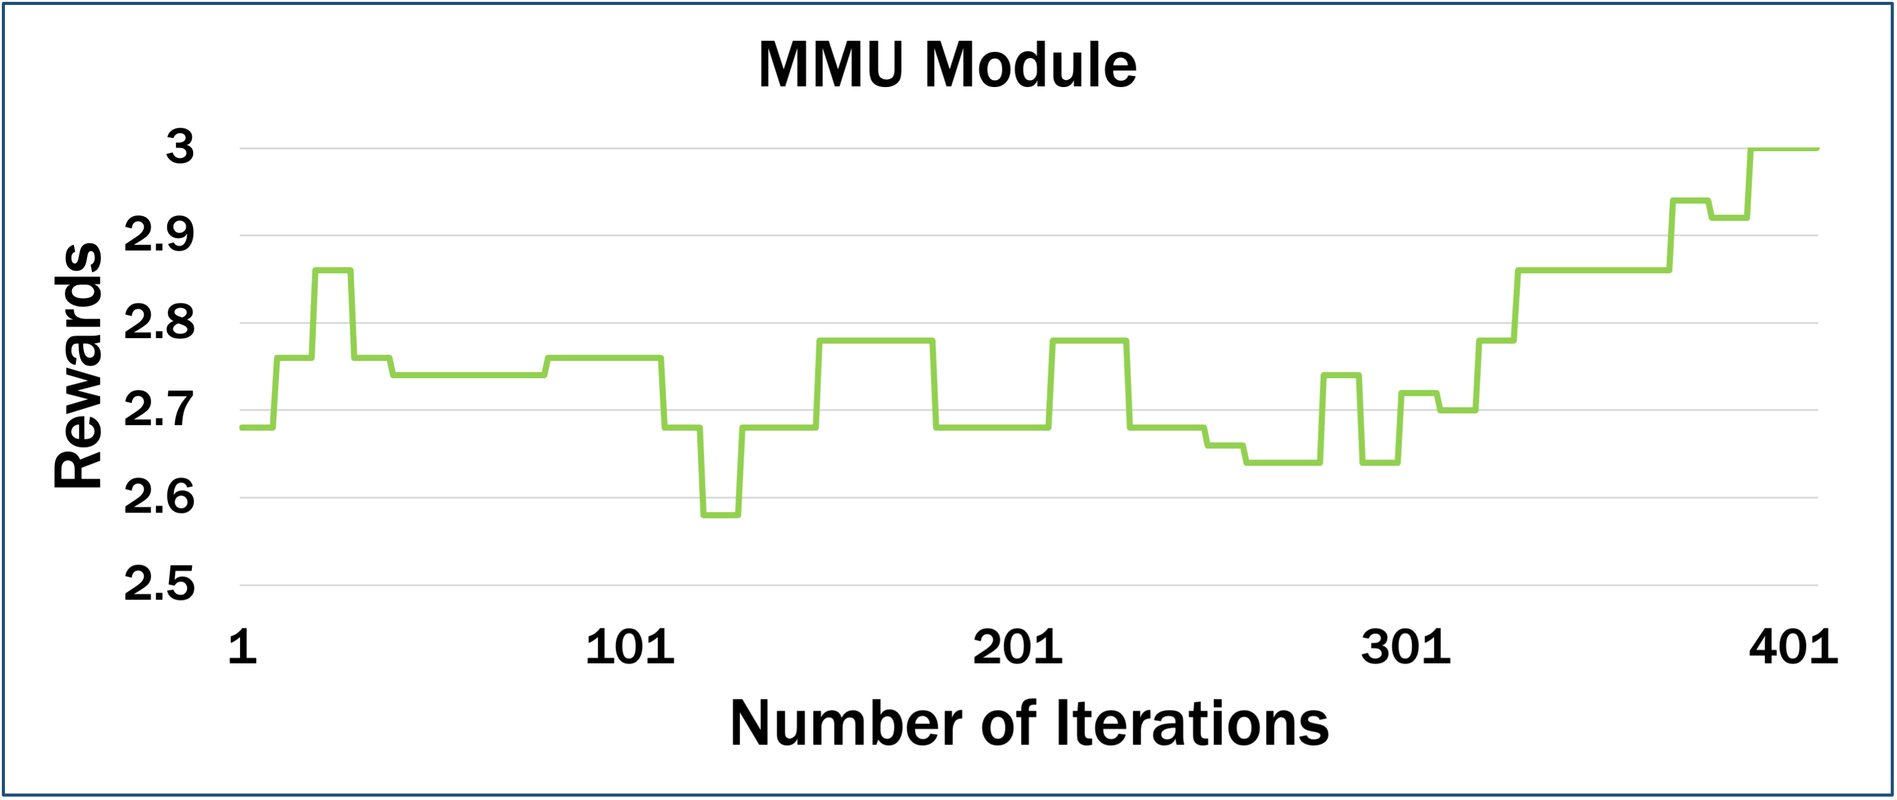
Task 2: Utilization of AI Model for Stimuli Generation for Fuzz Testing
Result Analysis
Cumulative rewards until one vulnerability detected for each module
AI agent achieves maximum rewards when a vulnerability is triggered
Rewards received by the SoCFuzzer+ AI agent

Slide 23
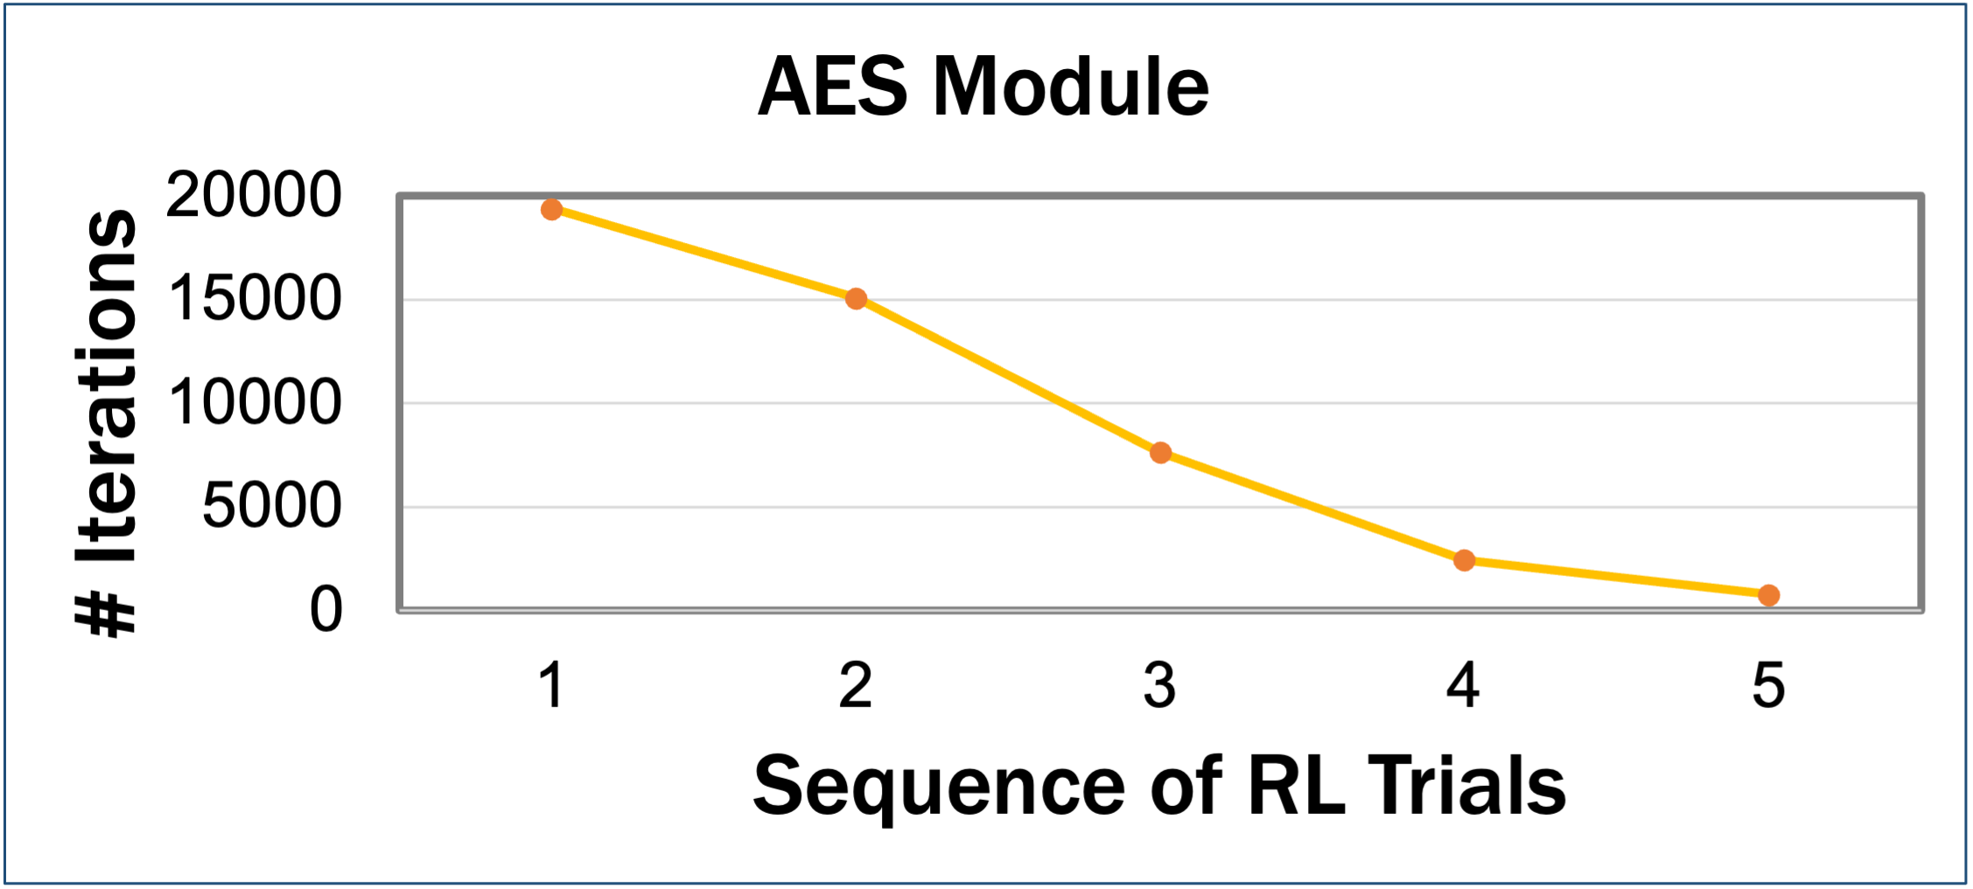
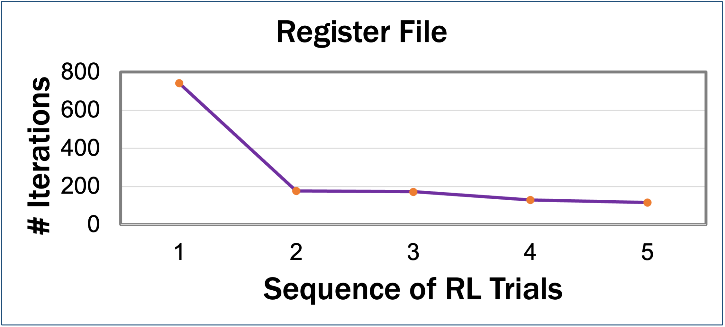
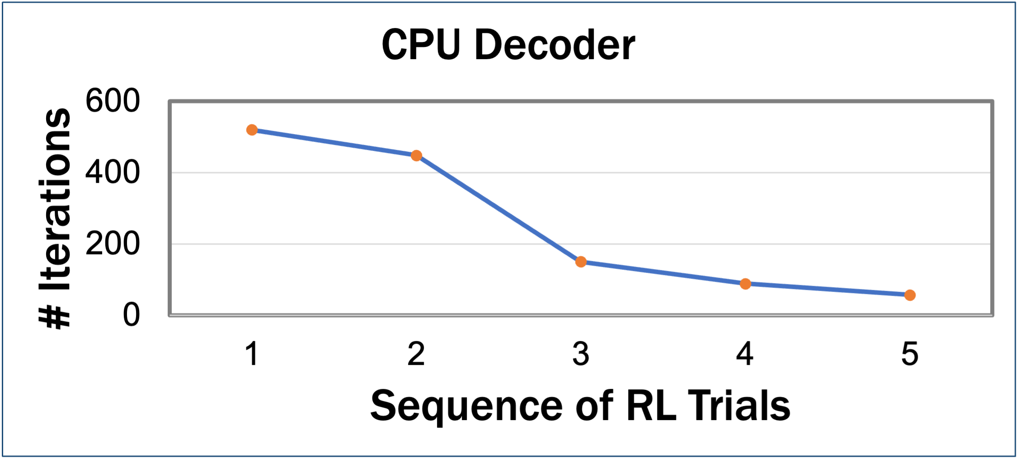
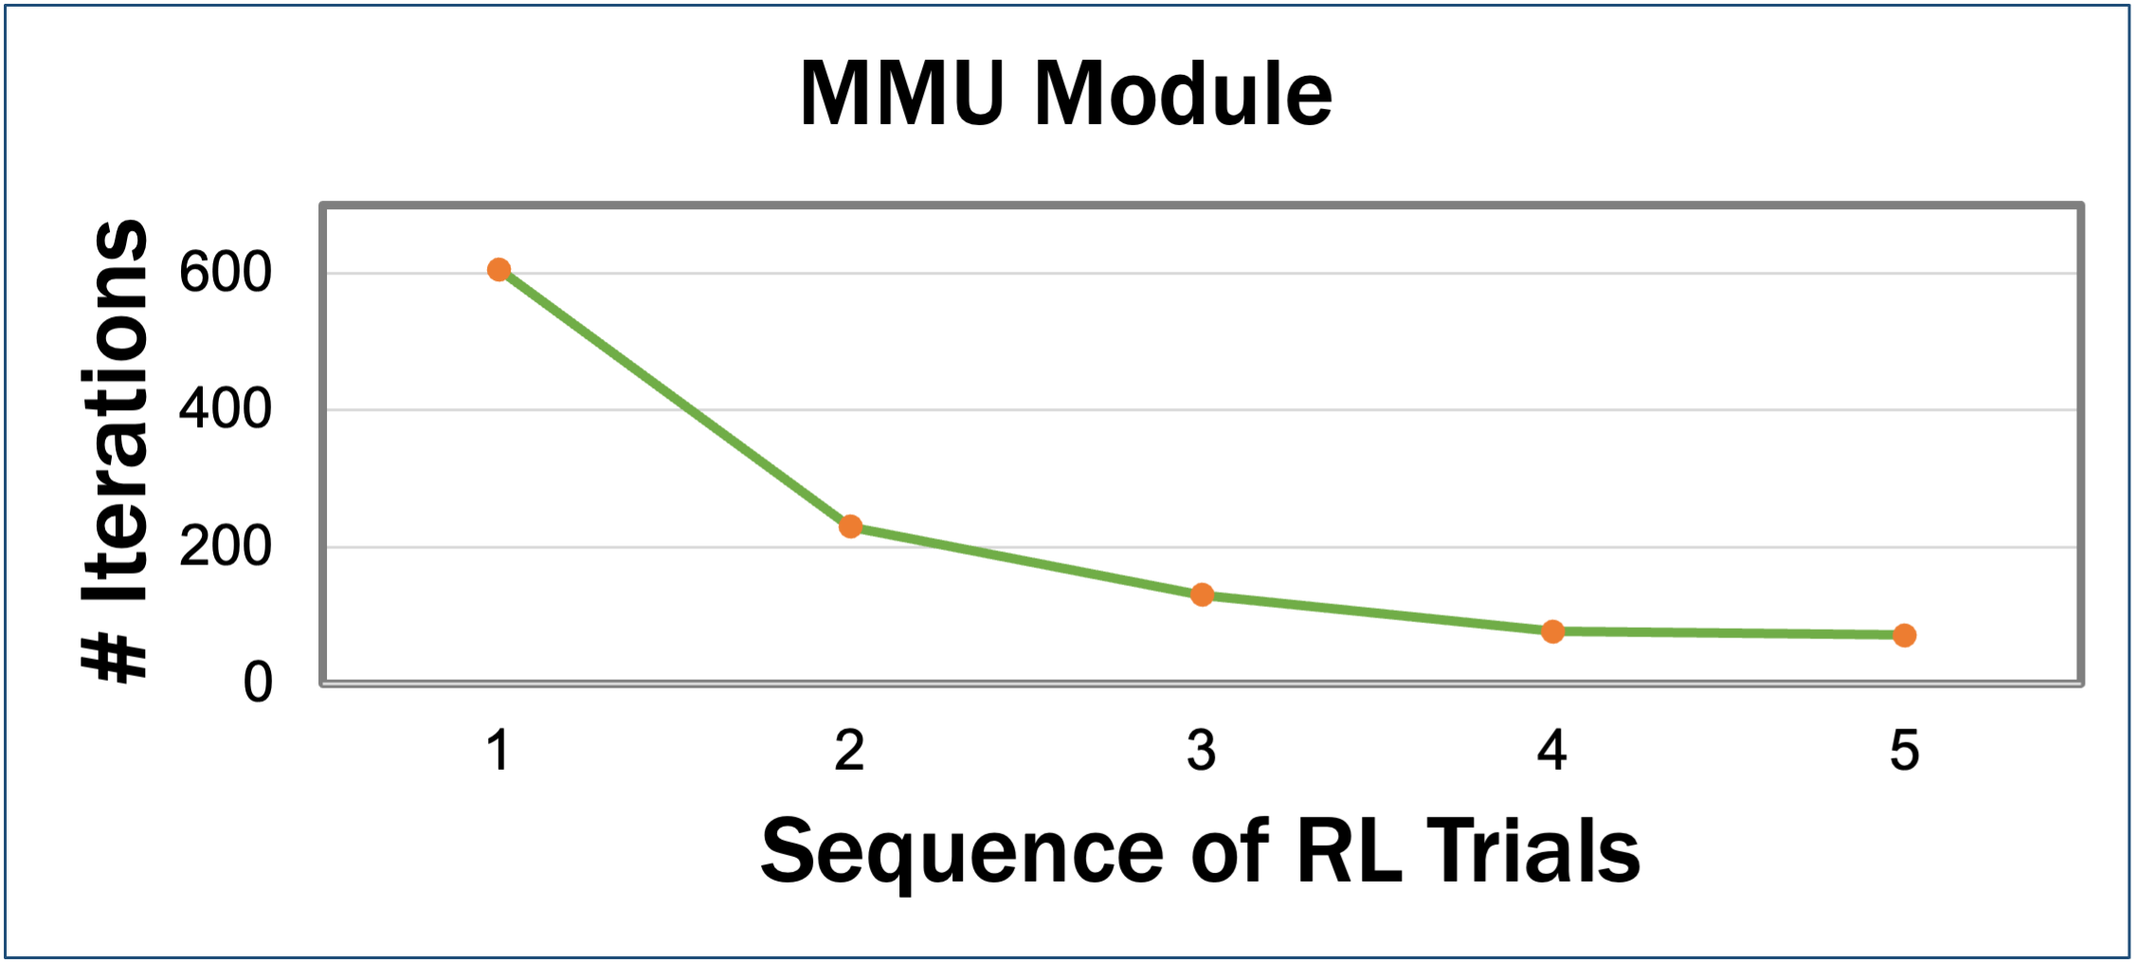
Task 2: Utilization of AI Model for Stimuli Generation for Fuzz Testing
Result Analysis
Decreasing iterations significantly for triggering a vulnerability over the trial in RL model
E.g., in worst case, first vulnerability detection in 20K, decreases to 15K in second trial
Performance evolution over the trials while verifying the Ariane SoC modules

Slide 24
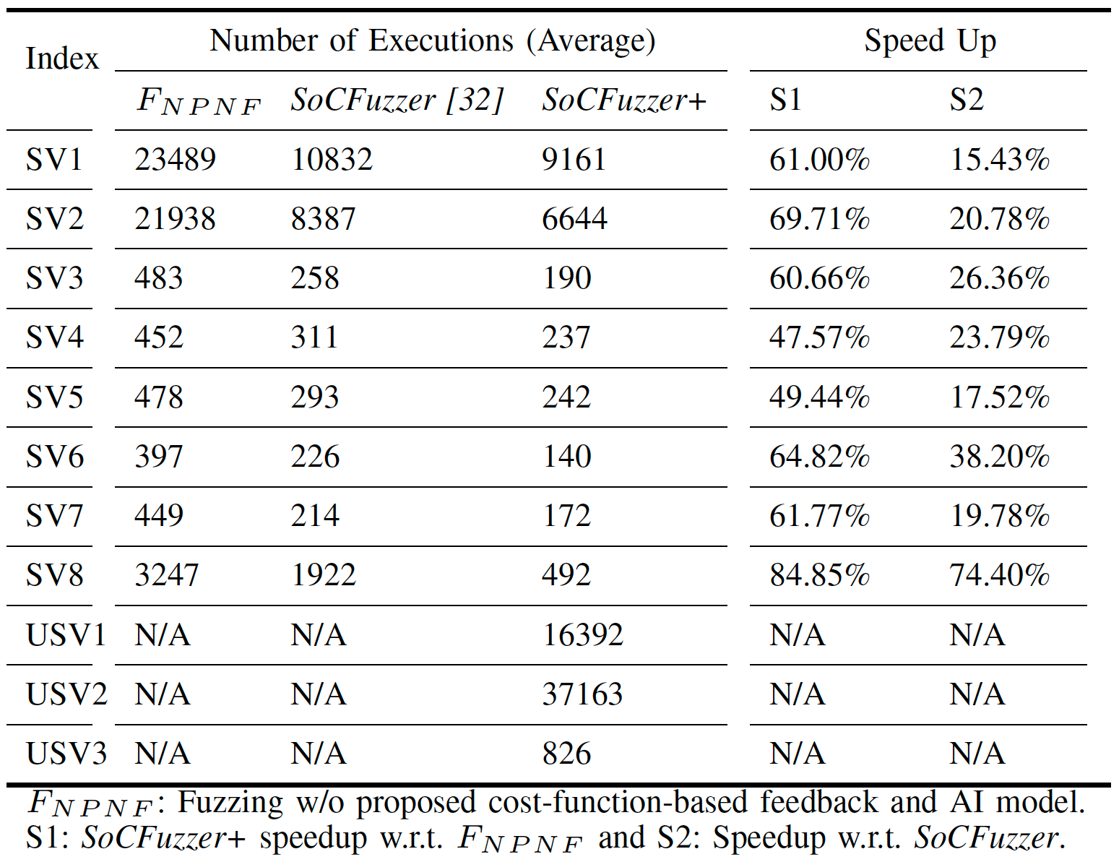
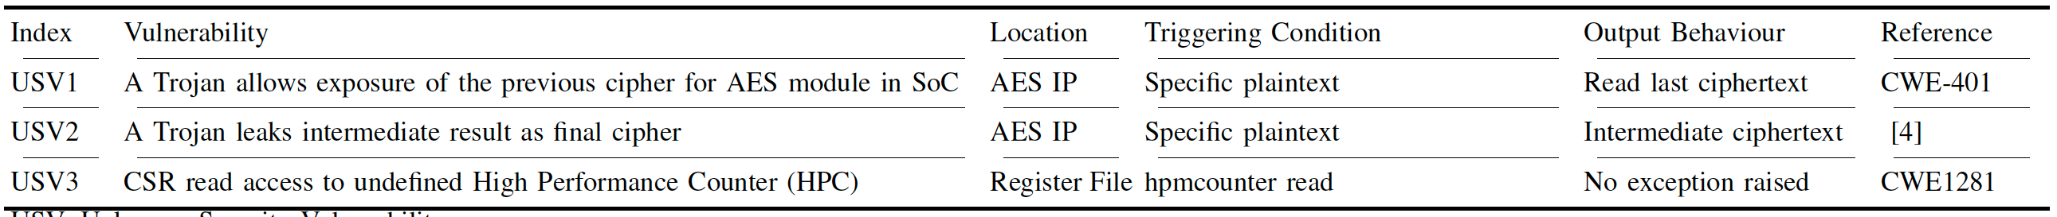
Task 2: Utilization of AI Model for Stimuli Generation for Fuzz Testing
Summary Results: Vulnerability Detection
Saved at least 47% of verification time comparing w/o proposed AI feedback
Saved at least 15% of verification time comparing to SoCFuzzer framework
Saved 23% verification time on average comparing to prior SoCFuzzer framework
Detected three unknown vulnerabilities
Unknown Vulnerability Detection

Slide 25
Publications
TECHCON 2023
Title: EmuFuzzer: Emulation-based Cost Function Guided Fuzzing for SoC Vulnerability Detection
Authors: Muhammad Monir Hossain, Kimia Zamiri Azar, Farimah Farahmandi, and Mark Tehranipoor
Others: ICCAD 2023 & IEEE TCAD
Title: TaintFuzzer: SoC Security Verification using Taint Inference-enabled Fuzzing
Authors: Muhammad Monir Hossain, Nusrat Farzana Dipu, Kimia Zamiri Azar, Fahim Rahman, Farimah Farahmandi, and Mark Tehranipoor (ICCAD 2023)
Title: SoCFuzzer+: SoC Vulnerability Detection Using Cost Function Enabled Reinforcement Learning Guided Fuzzing
Authors: Muhammad Monir Hossain, Nusrat Farzana Dipu, Kimia Zamiri Azar, Farimah Farahmandi, and Mark Tehranipoor (IEEE TCAD in review)

Slide 26
Summary
Met deliverables on time: Total deliverable(s) due: 1, Submitted: 5
Three publications in progress: TECHCON, ICCAD, TCAD
Discussed solution w/ industries and government
DARPA, LUCID, ECI, SYNOPSYS, NIMBIS, APPLE
Addressing problems and updating directions via meetings:
Among PI, Co-PI, and student
Feedback from Industrial personnel as well (In progress)

Slide 27
Future Work
Continue enhancements and experiments with proposed AI guided Fuzzing Framework (SoCFuzzer+)
Submit upcoming deliverable for next year
The implementation results on a set of RISCV-based SoCs, testing of both simulation- and emulation-based frameworks, analyzing the data, and improvement of the AI model ad fuzz test
Meeting w/ Industrial liaisons for thorough technical review
Updating research directions based on the feedback

Slide 28
Questions?
Muhammad Monir Hossain (hossainm@ufl.edu)
Dr. Farimah Farahmandi (farimah@ece.ufl.edu)
Dr. Mark Tehranipoor (tehranipoor@ece.ufl.edu)

